Slide 1
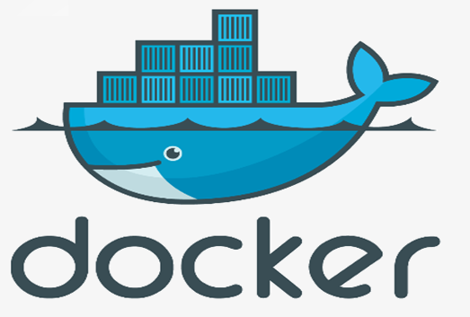

Slide 2
Monolith application
Security
IdP
App1
Config Server
App2
VM1
VM2

Slide 3
Monolithic Applications
In a monolithic application, the core problem is this: scaling monolithic is difficult. The resultant application ends up having a very large code base and poses challenges in regard to maintainability, deployment, and modifications
Monolithic Applications are huge, difficult to manage all the components like UI, database, message queue server, load balancers, web servers, storage
Frequent downtime as even a single module failure brings the system down due to the cascading effect
In order to do an Technology adoption or upgrade a technology stack, it would require the whole application to be upgraded, tested, and deployed
Server costs go high as its more expensive to buy bigger capacity hardware
Horizontal Scaling increases operational costs
High-risk in deployments as deploying an entire solution or application in one go poses a high risk as all modules are going to be deployed even for a single change in one of the modules
Higher testing time needed as to deploy the complete application, we will have to test the functionality of the entire application

Slide 4
User Concerns
Hotel
Server
App1
User 1
App2
User2
Libraries
Kitchen

Slide 5

User Concerns
It works fine on my machine
There is a Bug
Developer
Tester

Slide 6
User Concerns
What developers/tester care about :
Portable runtime environment
Missing dependencies, packages
Run tests faster
What sys-admins care about:
Cost & performance
Efficient, consistent & repeatable
Speed, reliability of CD & CI

Slide 7
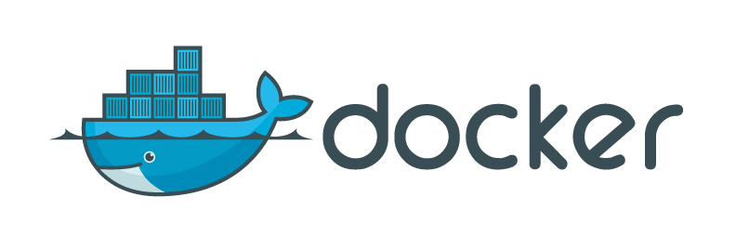
What is ?
Docker is a platform for developing, shipping & running applications using an open-source container based technology
OS level virtualization
Run everywhere – physical or virtual or cloud
Run anything – if it can run on host, it can run in the container

Slide 8
Why Docker
Scalable - lightweight
Portable – Docker’d Apps can run anywhere
Build any app in any language using any stack
You don't have to pre-allocate any RAM
Docker ensures your applications and resources are isolated and segregated
Environment Standardization and Version Control

Slide 9
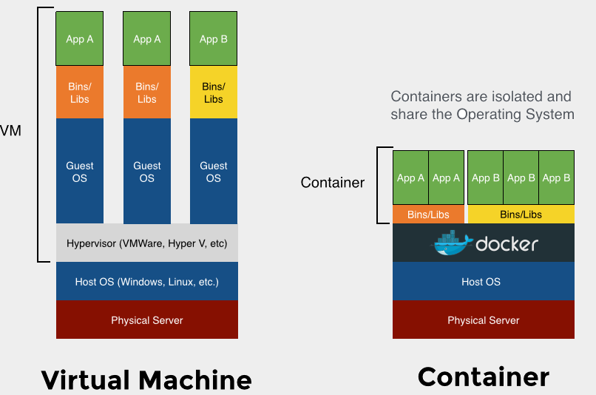
Virtualization vs Containers

Slide 10
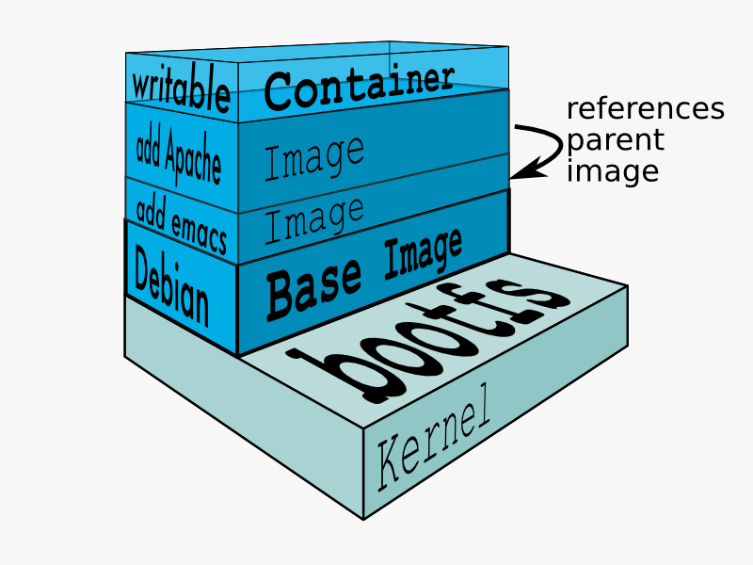
Docker images
Docker image is made up of file systems layered over each other
A Docker base image is nothing but an OS user space minus the kernel
Base is a boot filesystem, bootfs uses a Union File System & root filesystem stays in read-only mode
UnionFS allows files and directories of separate file systems, to be transparently overlaid, forming a single coherent file system.
Basically a tar file
When a container is launched from an image, Docker mounts a read-write filesystem on top of any layers below

Slide 11






Docker components
Core components :
Docker Daemon
Docker engine, runs on the host machine
Docker Client
CLI used to interact with the daemon
Workflow components :
Docker Image
Templates which holds the environment & your applications
Docker Container
Run-time instances created from images. Start, Stop, Run, Delete
Docker Registry
Public & Private repositories used to store images
Dockerfile
Automates image construction

Slide 12

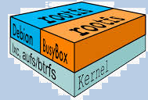

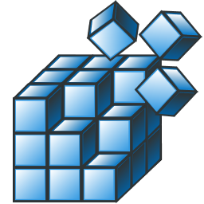
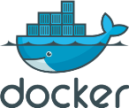
Docker system
Images
build
pull
push
commit
Dockerfile
start
stop
restart
Containers
Docker Registry

Slide 13
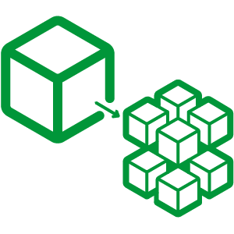
Microservice Architecture
Microservices architecture is an approach to develop a single application as a suite of small services, each running in its own process and communicating with lightweight mechanisms
Each component is continuously developed and separately maintained, and the application is then simply the sum of its constituent components
Benefits:
Developer independence: Small teams work in parallel and can iterate faster than large team
Isolation and resilience: If a component dies, you spin up another while and the rest of the application continues to function
Scalability: Smaller components take up fewer resources and can be scaled to meet increasing demand of that component only.
Lifecycle automation: Individual components are easier to fit into continuous delivery pipelines and complex deployment scenarios not possible with monoliths

Slide 14
Microservice solution using Docker
Compose the application using Docker
Break the application components into individual containers
Split the data that’s shared between services into volumes
Separate responsibilities so that each containers runs only one component/executable
Store the changeable data (configurations, logs) as Volumes so that they are mounted on various containers

Slide 15
Installing Docker CE (Community Edition)
Windows/OSX
Boot2Docker is a tiny VM which ships with
VirtualBox
Docker client
http://boot2docker.io/
CentOS
Set up the Docker CE repository
% yum install -y yum-utils
% yum-config-manager --add-repo https://download.docker.com/linux/centos/docker-ce.repo
Installing the Docker package
% yum -y install docker-ce ( use docker as the package for AWS AMI )
Starting the Docker daemon
% service start docker or systemctl start docker

Slide 16
Installing Docker CE on office VM
CentOS
Run below command to get root access.
$ dzdo su –
Set up the Docker CE repository
$ sudo yum install -y yum-utils
$ sudo yum-config-manager --add-repo https://download.docker.com/linux/centos/docker-ce.repo
adjust the below parameter in file /etc/yum.repos.d/docker-ce.repo
From: [docker-ce-stable]
name=Docker CE Stable - $basearch
baseurl=https://download.docker.com/linux/centos/$releasever/$basearch/stable
enabled=1
gpgcheck=1
gpgkey=https://download.docker.com/linux/centos/gpg
TO:
[docker-ce-stable]
name=Docker CE Stable - $basearch
baseurl=https://download.docker.com/linux/centos/8/$basearch/stable
enabled=1
gpgcheck=1
gpgkey=https://download.docker.com/linux/centos/gpg

Slide 17
Installing Docker CE on office VM continued…..
Installing the Docker package
$ yum -y install docker-ce docker-ce-cli containerd.io
If prompted to accept the GPG key, verify that the fingerprint matches 060A 61C5 1B55 8A7F 742B 77AA C52F EB6B 621E 9F35, and if so, accept it.
Starting the Docker daemon
$ sudo systemctl start docker
Verify that Docker Engine is installed correctly by running the hello-world image.
$ sudo docker run hello-world
This command downloads a test image and runs it in a container. When the container runs, it prints an informational message and exits.

Slide 18
First steps with Docker
Ensuring Docker is ready
$ docker info
Docker run command
$ docker run -i -t ubuntu //bin/bash
-i = keeps STDIN open from the container
-t = assings a pseudo tty to the container
% hostname
% cat /etc/hosts
% ps –aux
% apt-get update
% apt-get install vim
% exit

Slide 19
Container naming
$ docker run --name adam_the_container -it ubuntu //bin/bash
Starting a stopped container
$ docker start adam_the_container
Attaching a container
$ docker attach adam_the_container
Creating daemonized containers
$ docker run --name adam_new -d ubuntu //bin/sh -c "while true; do echo hello world; sleep 5; done"
Fetch logs of a container
$ docker logs –f adam_new

Slide 20
Stopping a container
$ docker stop adam_new
List containers
$ docker ps
-a = lists all containers
-q = shows only container ID
Deleting a container
$ docker rm adam_new
Inspecting the container's processes
$ docker top adam_new
$ docker inspect <containerid>
$ docker inspect --format '{{ .NetworkSettings.IPAddress }}’ <containerid>
$ docker inspect --format='{{ .State.Running }}‘ <containerid>

Slide 21
Run a command in a running container without attaching to it
$ docker exec <containerID>
% docker exec adam_new hostname
% docker exec adam_new ls
Display a live stream of container(s) resource usage statistics
$ docker stats [containerIDs] apt-get update or apt-get install –y apache2
Get real time events from the server
$ docker events --filter [container|event|image|label|type|volume|network|daemon
% docker events --filter event=attach --filter event=die
% docker events --since ‘1h’
Exposing Our Container With Port Redirects
- All ports are private by default
- When you docker run -p <port> ..., that port becomes public
- When you docker run -P ... (without port number), Publish all exposed ports to random ports
$ docker run -p <hostport>:<containerport> nginx:latest
% docker run –d -p 80:80 nginx:latest
Notes:
“netstat –listen” to get the list of ports being used in the server

Slide 22
Data Volumes :
A volume is a specially designated directory within one or more containers that bypasses the Union File System
• Volumes can be shared and reused between containers.
• A container doesn't have to be running to share its volumes.
• Changes to a volume are made directly.
• Changes to a volume will not be included when you update an image.
Volumes declared from cmd-line
$ docker run –it –v /usr/data ubuntu
Sharing Volumes across containers [ Data containers ]
This is done using the --volumes-from flag for docker run
$ docker run --privileged=true –it –volumes-from test1 ubuntu
$ docker run --privileged=true –it –volumes-from test1 –volumes-from test2 ubuntu
Sharing a directory between the host and a container
$ docker run –it –name test1 -v /home/user/Docker:/data ubuntu

Slide 23
Rename a container
$ docker rename <src> <dest>
Show current available images
$ docker images
Search for images
$ docker search ubuntu
Download images
$ docker pull debian:jessie

Slide 24
Building Images Interactively
Create a new container and make some changes
$ docker run --name adam_the_container -i -t ubuntu
% apt-get install vim
% exit
Inspect the changes
$ docker diff adam_the_container
Commit & run your image
$ docker commit adam_the_container
$ docker commit adam_the_container myfirstImage
$ docker run -it <newImageId>
Tagging images
$ docker tag <newImageId> myfirstImage
Notes:
Example:
docker run --name artifactory-5.0.0 -d -v /var/opt/jfrog/artifactory:/var/opt/jfrog/artifactory -p 8081:8081 docker.bintray.io/jfrog/artifactory-oss:latest

Slide 25
Dockerfile instructions
RUN : Run the command when the container is being built
CMD :
Specifies the command to run when a container is launched, if values are specified during launch it will override the Dockerfile value
% CMD ["echo", "Hi"]
$ docker build -rm -t="adam/dockerfiles" .
$ docker run -it adam/dockerfiles
ENTRYPOINT :
Same as RUN, arguments we specify on the docker run command line will be passed as arguments to the command specified in the ENTRYPOINT
% ENTRYPOINT ["echo", "Hi"]
WORKDIR :
Provides a way to set the working directory for the container and the ENTRYPOINT and/or CMD to be executed when a container is launched from the image.
% WORKDIR /usr/bin
- You can override the working directory at runtime with the -w flag
$ docker run -it -w /var adam/dockerfiles

Slide 26
Building Docker Images
Create a test dir & a Dockerfile
% mkdir Test; cd test && vim Dockerfile
FROM ubuntu
RUN apt-get -y install vim
Build the image
$ docker build -t myFirstImage .
Running the built image
$ docker run -it myFirstImage
List all the layers composing an image
$ docker history myFirstImage

Slide 27
ENV :
set environment variables during the image build process
% ENV ORACLE_HOME /var
USER :
specifies a user that the image should be run as
% USER nobody
- You can override this at runtime by specifying the -u flag with
$ docker run -it -u nobody adam/dockerfile
VOLUME (data volumes) :
% VOLUME ["/data" ]

Slide 28
COPY :
Adds files and directories from our build environment into our image
% COPY readme /data1
- this will add the readme file from the build dir to /data in the image
ADD:
Similar to COPY, whereas it can extract archives
% ADD latest.tar.gz /var/www/wordpress
MAINTAINER :
Tells you who wrote the Dockerfile
% MAINTAINER ADAM TRAVIS "scmlearningcentre@gmail.com"
EXPOSE :
Tells Docker what ports are to be published in this image
% EXPOSE 8080

Slide 29
Sample Dockerfile to setup Apache2
FROM ubuntu:12.04
MAINTAINER ADAM
RUN apt-get update && apt-get install -y apache2 && apt-get clean && rm -rf /var/lib/apt/lists/*
ENV APACHE_RUN_USER www-data
ENV APACHE_RUN_GROUP www-data
ENV APACHE_LOG_DIR /var/log/apache2
EXPOSE 80
CMD ["/usr/sbin/apache2", "-D", "FOREGROUND"]
$ docker build -t apacheimg -f ./Dockerfileapache .
$ docker run -d -p 80:80 -v /var/www:/var/www apacheimg
Notes:
On Ubuntu Apache DocumentRoot is “/var/www” & in Centos its /var/www/html

Slide 30
Sample Dockerfile to setup Mongodb
############################################################
# Dockerfile to build MongoDB container images
# Based on Ubuntu
############################################################
# Set the base image to Ubuntu
FROM ubuntu
# File Author / Maintainer
MAINTAINER Example ADAM
# Update the repository sources list
RUN apt-get update
################## BEGIN INSTALLATION ######################
# Install MongoDB Following the Instructions at MongoDB Docs
# Ref: http://docs.mongodb.org/manual/tutorial/install-mongodb-on-ubuntu/
# Add the package verification key
RUN apt-key adv --keyserver hkp://keyserver.ubuntu.com:80 --recv 7F0CEB10
# Add MongoDB to the repository sources list
RUN echo 'deb http://downloads-distro.mongodb.org/repo/ubuntu-upstart dist 10gen' | tee /etc/apt/sources.list.d/mongodb.list
# Update the repository sources list once more
RUN apt-get update
# Install MongoDB package (.deb)
RUN apt-get install -y mongodb-10gen
# Create the default data directory
RUN mkdir -p /data/db
##################### INSTALLATION END #####################
# Expose the default port
EXPOSE 27017
# Default port to execute the entrypoint (MongoDB)
CMD ["/usr/bin/mongod", "--config", "/etc/mongodb.conf"]

Slide 31
Build the Image using the new Dockerfile for Mongodb
$ docker build -t mongodbimg -f ./DockerfileMongo .
$ docker run -d -p 28001:27017 mongodbimg
Installing Jenkins with Docker
$ docker run -p 8080:8080 --name=jenkins-master -d --env JAVA_OPTS="-Xmx8192m" jenkins
Deleting images
$ docker rmi adam/dockerfiles
$ docker rmi `docker images -a -q`
Notes:
Note: You need to have Mongodb installed in your host machine to access this installation
$ mongo --port 28001

Slide 32
Sample httpd application
Build the Image using the new Dockerfile for simple node app.
Create a folder in vm and create Dockerfile & index.html.
Run below commands
$ docker build .
$ docker images
$ docker tag [img_id] myhttpd:1.0
$ docker run -d -it --name mywebserver -p <vm_ip>:80:80 myhttpd
$ docker ps
$ curl <vm_ip>:80

Slide 33
Sample node js application
Build the Image using the new Dockerfile for simple node app.
Create a folder in vm and copy contents of the zip file.
Run below commands
$ docker build .
$ docker images
$ docker tag [img_id] nodejs_app:1.0
Try running with following command and access it through browser
$ docker run -d -it --name nodejs_app nodejs_app:1.0
Currently, the app is not accessible from outside of the vm.
$ docker ps
$ docker stop [CONTAINER ID]
Run below command with port forwarding option
$ docker run -d -it --name nodejs_app -p <vm_ip>:9005:9005 nodejs_app:1.0
$ docker ps

Slide 34
Deploying a registry server
Start your registry: starting as a container
$ docker run –d –p 5000:5000 –restart=always –name registry registry:2
Pull an image from docker registry
$ docker pull ubuntu:16.04
Tag a image in the registry
$ docker tag ubuntu:16.04 localhost:5000/my-ubuntu
Push image to registry
$ docker push localhost:5000/my-ubuntu
Pull image from registry
$ docker pull localhost:5000/my-ubuntu

Slide 35
Deploying a registry server
Remove locally-cached image
$ docker image remove ubuntu:16.04
$ docker image remove localhost:5000/my-ubuntu
Pull the localhost:5000/my-ubuntu image from your local registry.
$ docker pull localhost:5000/my-ubuntu
Stop the registry
$ docker stop registry
$ docker rm –v registry

Slide 36
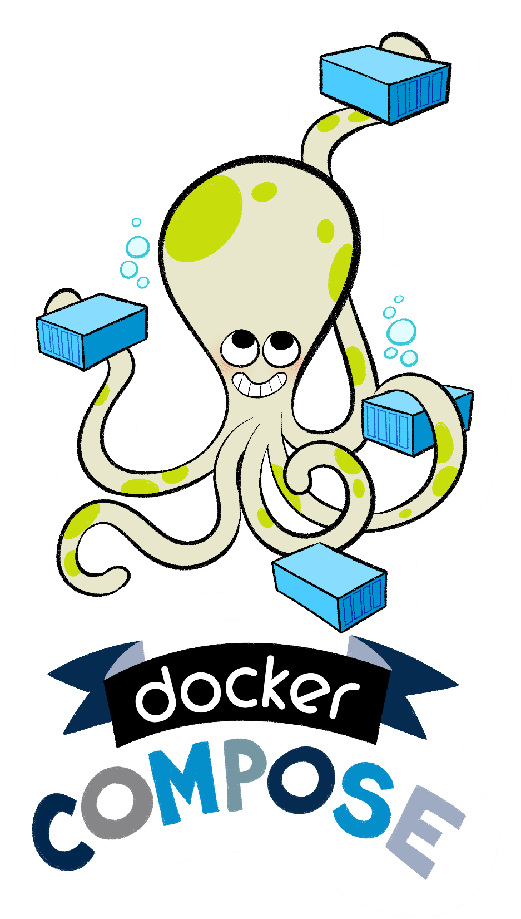

Slide 37
What is Docker Compose ?
Compose is a tool for defining and running multi-container Docker applications
With Compose, you use a Compose file to configure your application's services. Then, using a single command, you create and start all the services from your configuration
Compose has commands for managing the whole lifecycle of your application:
Start, stop and rebuild services
View the status of running services
Stream the log output of running services
Run a one-off command on a service

Slide 38
Using Compose is basically a three-step process:
Define your app's environment with a Dockerfile so it can be reproduced anywhere.
Define the services that make up your app in docker-compose.yml so they can be run together in an isolated environment.
Lastly, run docker-compose up and Compose will start and run your entire app

Slide 39
Install Compose on Linux systems:
https://docs.docker.com/compose/install/#install-compose
curl -L https://github.com/docker/compose/releases/download/1.27.4/docker-compose-`uname -s`-`uname -m` -o /usr/local/bin/docker-compose
chmod +x /usr/local/bin/docker-compose

Slide 40
Docker compose file is like an configuration file, where you define all the different stuffs we perform on command line into a file.
The file is basically an Yaml file (.yml)
Default file is docker-compose.yml
Examples: https://github.com/scmlearningcentre/docker.git

Slide 41
$ docker-compose -f <composefile> <options>
$ docker-compose up -d <service>
$ docker-compose ps
$ docker-compose images
$ docker-compose logs –f <service>
$ docker-compose stop <service>
$ docker-compose rm <service>
$ docker-compose build <service>
$ docker-compose up --scale <service>=<Num>

Slide 42
Docker-compose Sample app
mynode
mymongo
app
db

